Slide 1
GOJO
Jenny & Gary Owens
gojonamebadges@gmail.com
14 Spencer Avenue Deception Bay QLD 4508
0415416812
Authorized Toastmasters International Vendor
ABN 93927449514
Notes:
NOTE:
To change the image on this slide, select the picture and delete it. Then click the Pictures icon in the placeholder to insert your own image.

Slide 2
GOJO Awards and Badges
These Awards are a selection available and suitable for Club, Area and Division
Prices shown include engraving
Award Postage (variable on weight and size) from $12 (all postal prices have risen from 5.9.2022)
# indicates award shown in photograph
Some pictures are shown of available trophies with sand etching. I apologize as I am unable to do this.
Sublmating Plating or engraved plating will be applied to these type of trophies

Slide 3
Name badges
Toastmaster
And Community

Slide 4
BADGES
MEMBER
DTM
Badge with Backs
A Pin $8.50
B Alligator Clip $9.00
C Magnet $10.00
P&H up to badges =$4
5 – 8 badges = $6
> 8 badges = $10

Slide 5
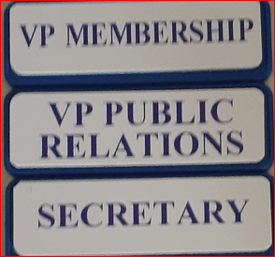
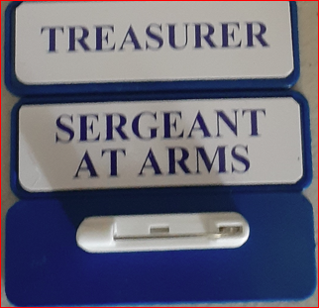
TOASTMASTER EXECUTIVE BADGES
DTM
$4.00 Each
$24.00 full set of 7

Slide 6
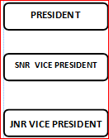
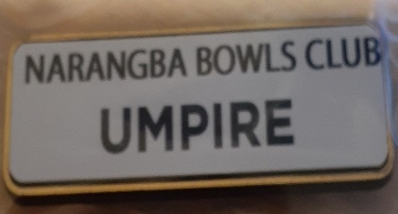
Community Badges Executive Badges
Badge with Backs
A Pin $8.50
B Alligator Clip $9.00
C Magnet $10.00
P&H up to badges =$4
5 – 8 badges = $6
> 8 badges = $10

Slide 7
GLASS AWARDS

Slide 8
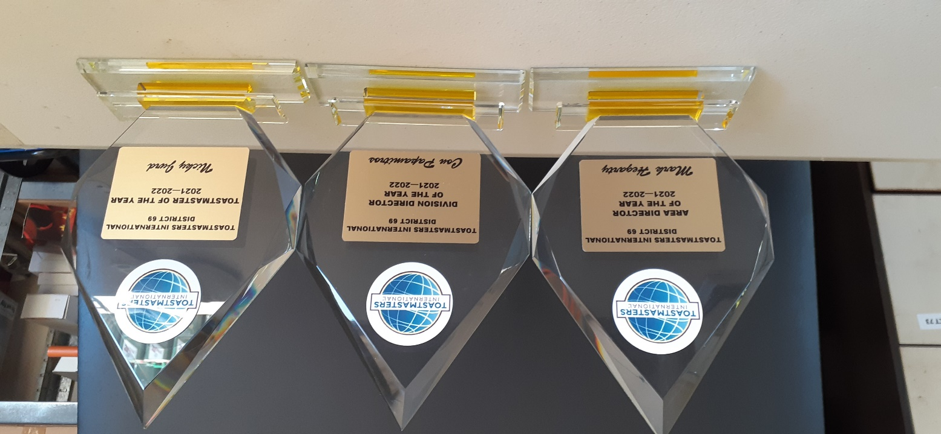
GLASS AWARDS
JG07A * JG07B JG07C
Arrow Jade Crystal
180mm height 220mm 270 mm
$30 $ 35 $40
Add postage & handling
$20

Slide 9
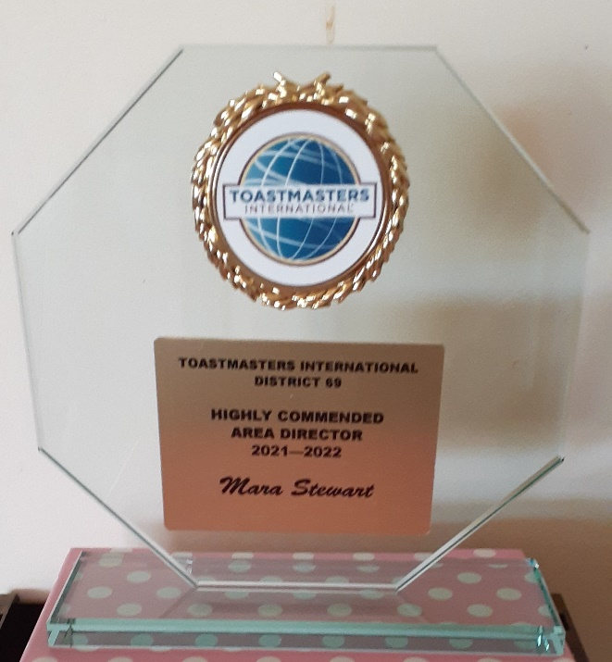
GLASS AWARDS Budget Glass
BGT6A BGT6B BGT8C
Octagonal Octagonal Octagonal
115mm height 165mm 190mm
S15 $18 $21
Add postage & handling
$15 +-

Slide 10
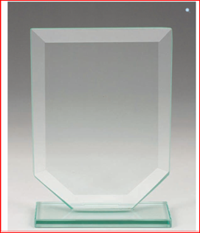
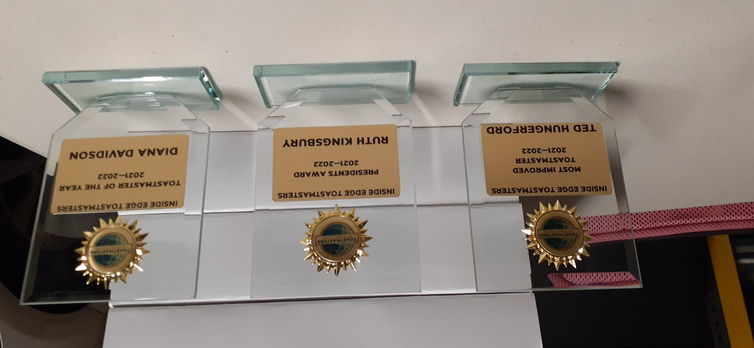
GLASS AWARDS Budget Glass
BGT8A * BGT8B BGT8C
115mm height 165mm 190mm
S15 $18 $21
Add postage & handling
$15

Slide 11
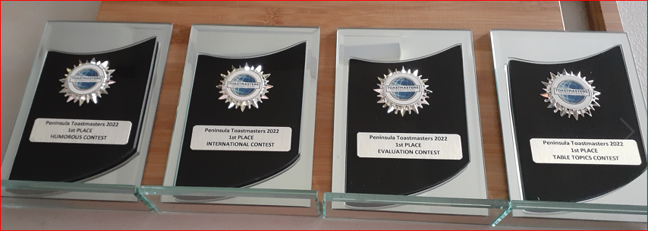
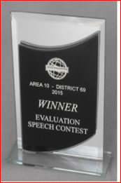
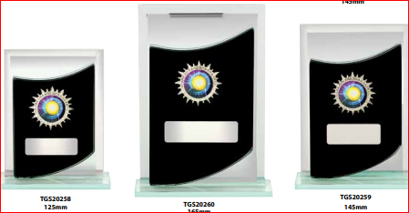
GLASS AWARDS : FLARE SILVER / BLACK
A Small BMG2A = 125mm $ 20.00
B Medium BMG2B = 145mm $ 22.00
C Large BMG2C = 165mm $ 24.00*

Slide 12
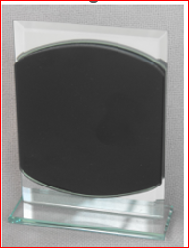
GLASS AWARDS
Blaze silver / black
BMG5A 125MM $20
BMG5B 145MM $22.00
BMG5C 165MM $24.00*

Slide 13
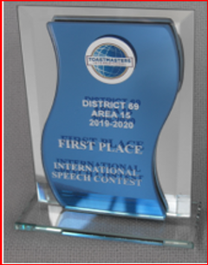
GLASS AWARDS Mirage Silver / Blue
A BMG 1A 125mm height $20.00*
B BMG 1B 145mm height $22.00
C BMG 1C 165mm height $24.00

Slide 14
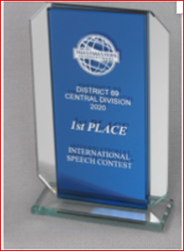
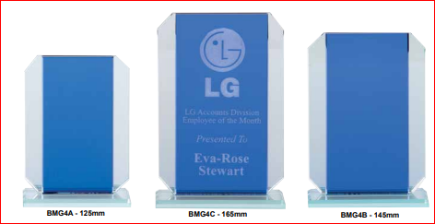
GLASS AWARDS Cosmic Silver/Blue
A Small BMG4A 125mm height $ 20.00
B Medium BMG4B 145mm height $ 22.00
C Large BMG4C 165mm height $ 24.00*

Slide 15
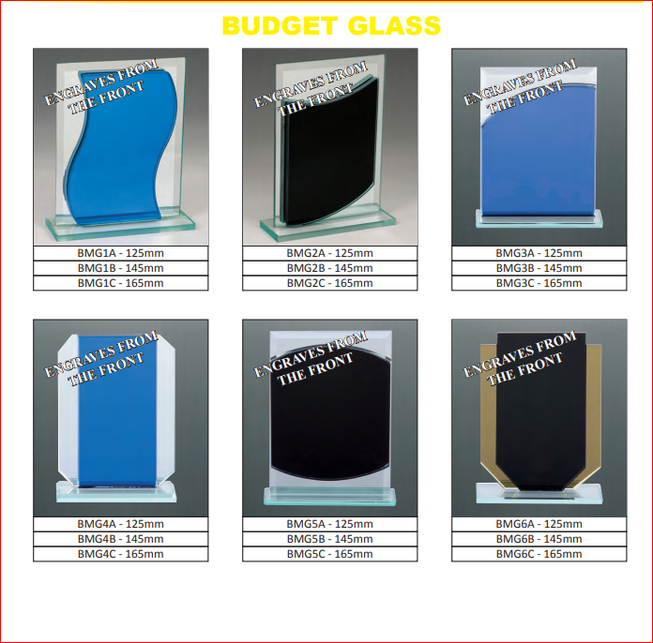
Glass Awards -Budget

Slide 16
Awards- Crystal Glass

Slide 17
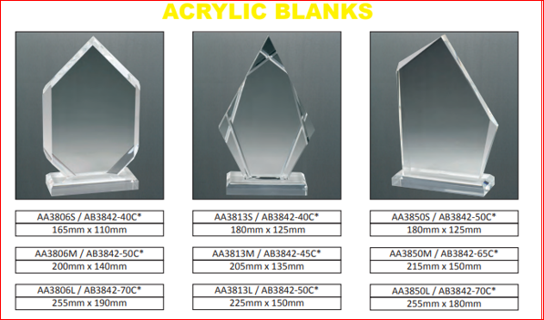
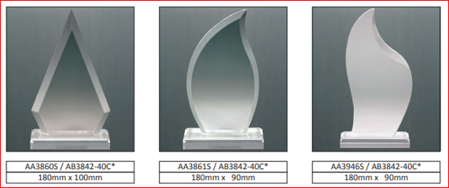
GLASS AWARDS Acrylic Blanks

Slide 18
Acrylic

Slide 19
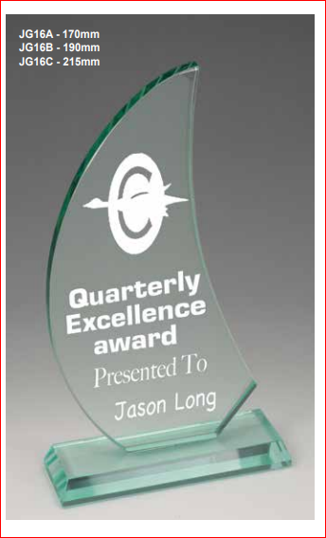
Glass Awards -

Slide 20
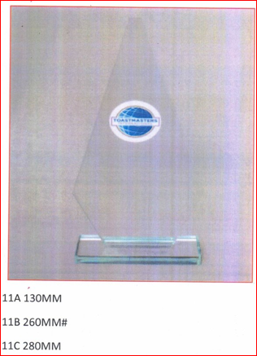
Glass Awards

Slide 21
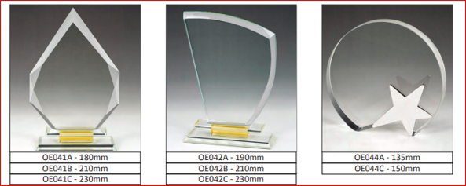
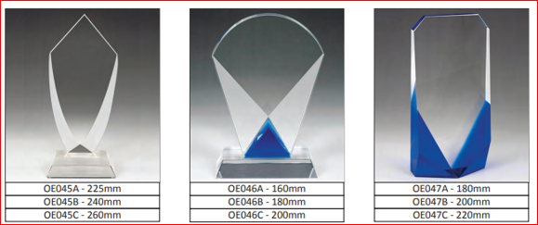
Glass Awards

Slide 22
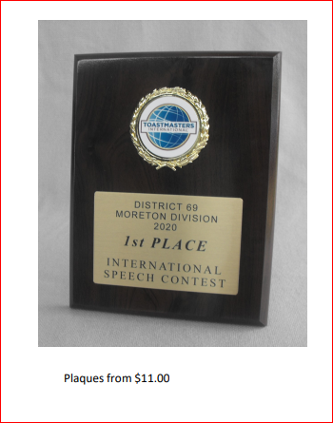
PLAQUES

Slide 23
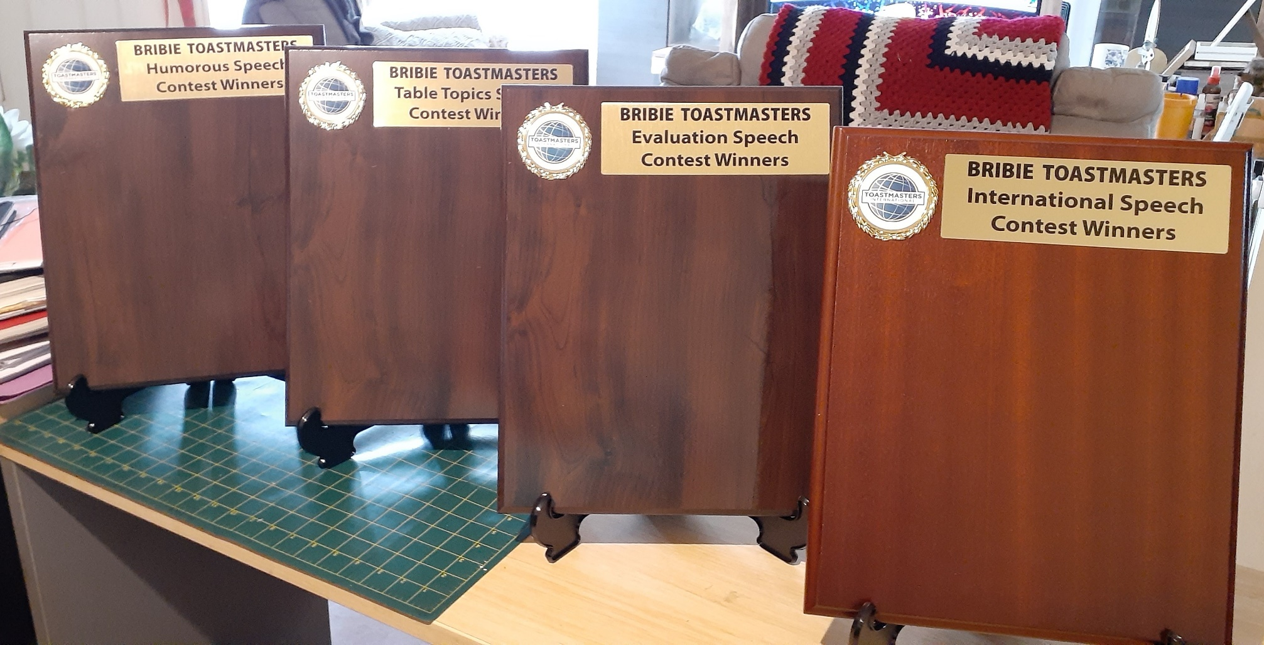
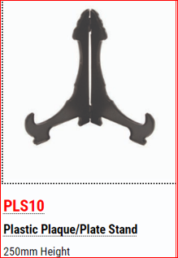
Perpetual Awards
Each plaque pictured is 305mm x 380mm x 18mm
No strut
$30 each
To add a metal plate with year and recipient name is $5.00 each plate
Plate stand $8

Slide 24
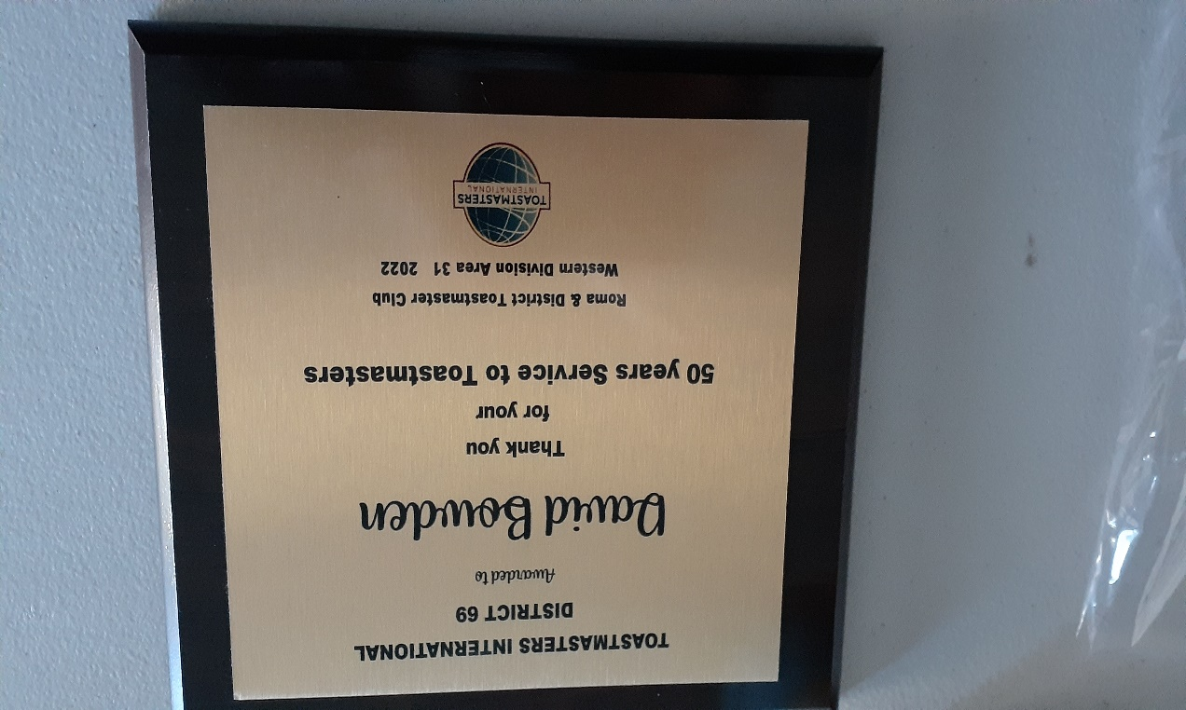
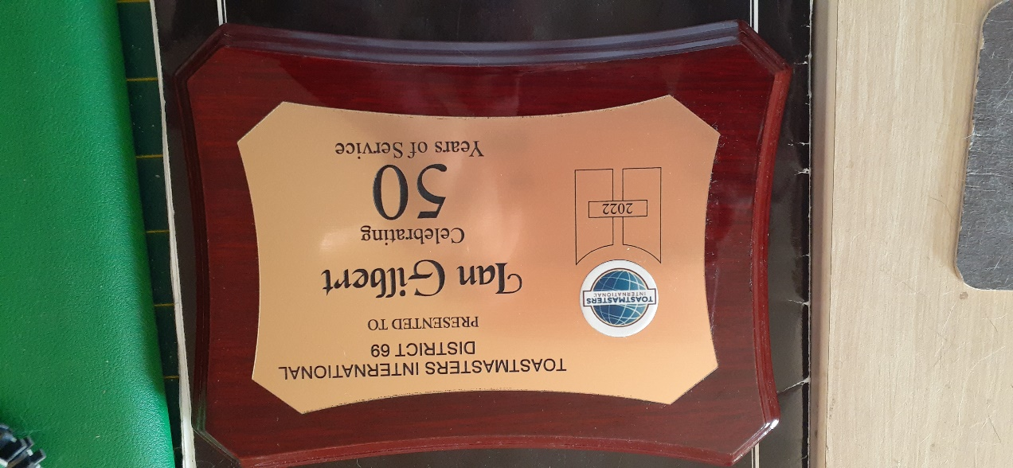
Special Awards
$ 30 plaques

Slide 25
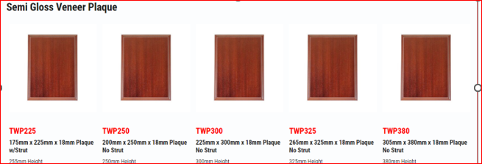
Plaques

Slide 26
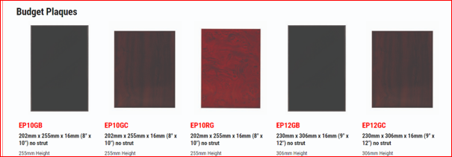
Plaques

Slide 27
Plaques

Slide 28
Plaque Pricing
110 x 153mm (4” x 6”) $11.00
125 x 180 (5 x 7”) $12.00
153 x 202 (6 x 8”) $14.00
175mm x 225mm $ 15.00
180 x 230 (7” x 9“) $16.00
202 x 255 (8” x 10”) $18.00
200x 250 $20.00 (pictured)
225 x 300 $22.00
220mm x 165mm $23.00
230 x 306 (9” x 12”) $24.00
265 x 330 (10” x 13”) $25.00
305 x 380 $28.00
306 x 382 (12” x 15”) $30.00
382 x 457 (15” x 18”) $32.00
406 x 508 (16 x 20”) $35.00

Slide 29
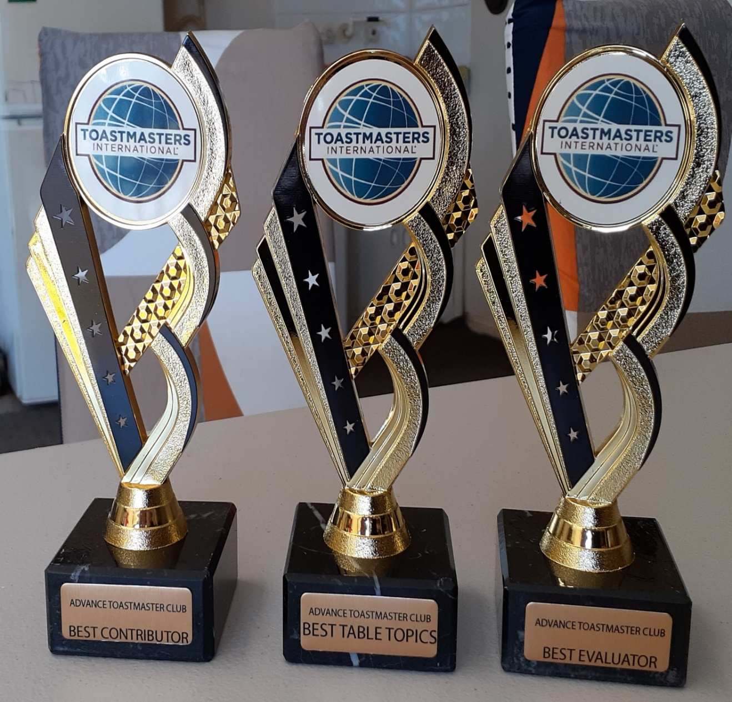
TROPHY AWARDS

Slide 30
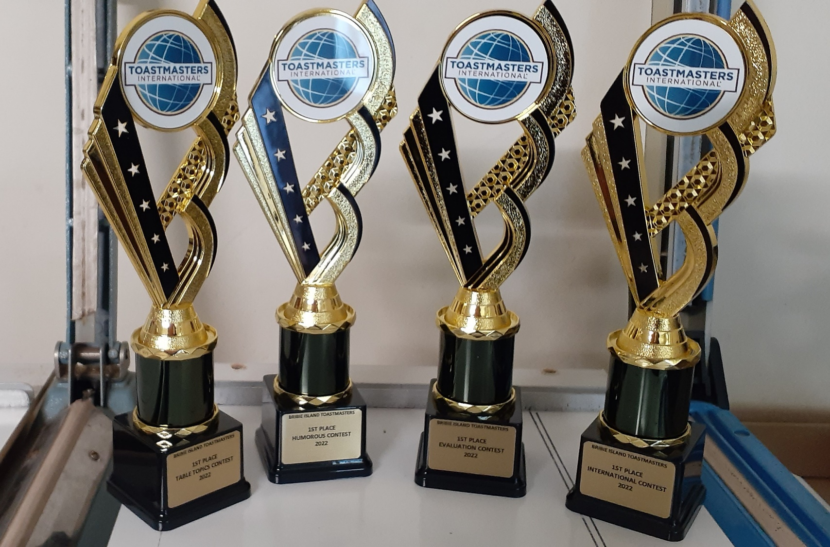
Trophy Awards
EH12GBK gold black
EH12GBL gold blue
EH12SBK silver black
EH12SBL silver blue
Small $15
Medium $18*
Large $21

Slide 31
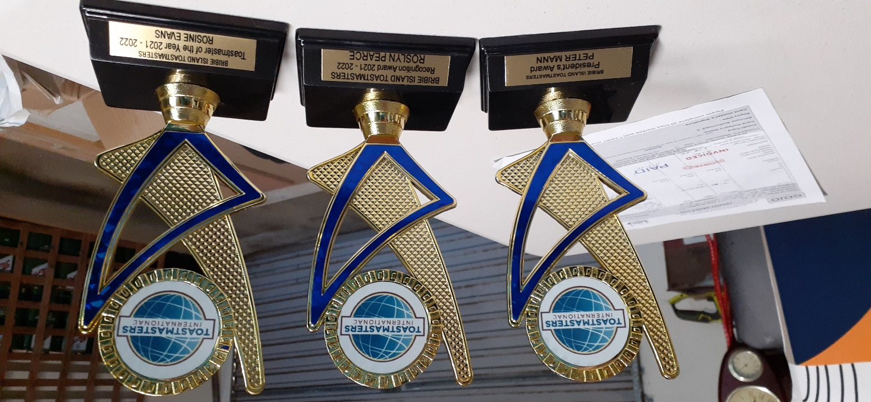
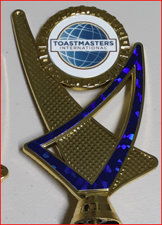
Trophy Awards
Colours Blue/gold or Black/gold
TGG20038 245mm $20
TGG20037 230mm $15
TGG20036 185mm $10*
Colours Blue/Silver or Black/silver
TGG20033 185mm $10
TGG20034 230mm $15
TGG20035 245mm $20

Slide 32
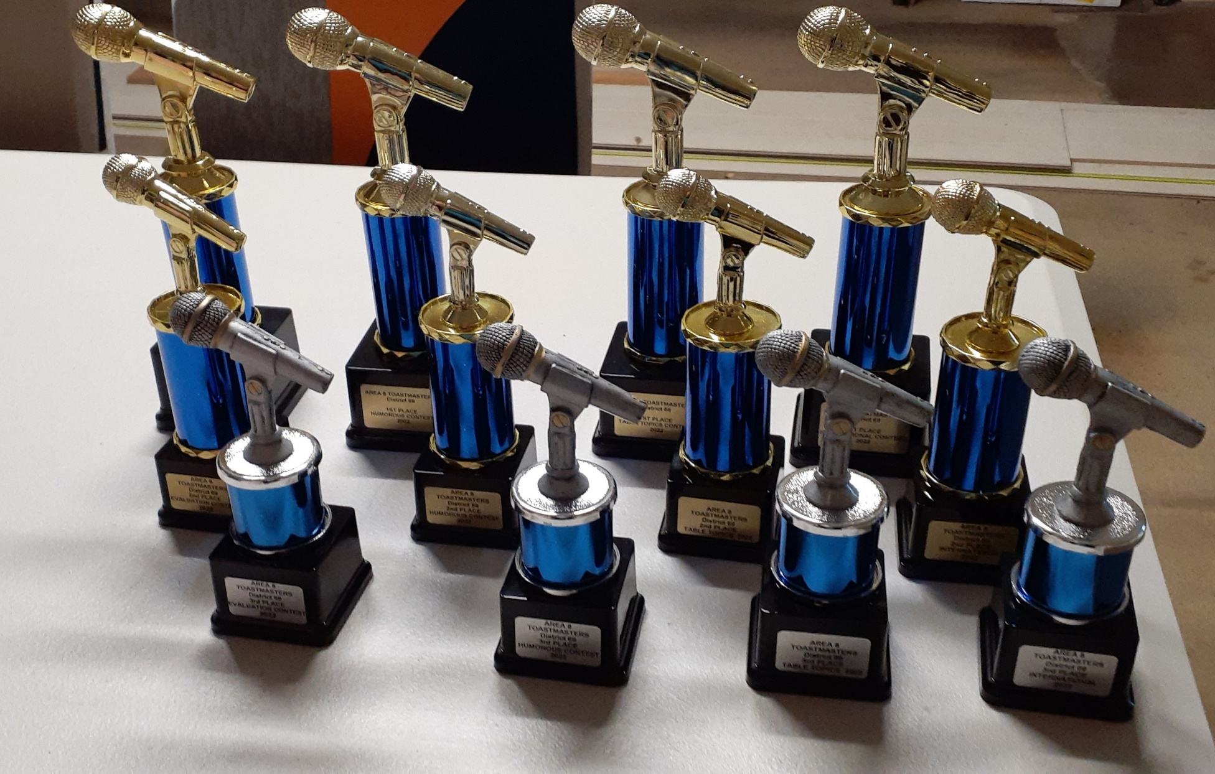
Microphones
Small $10
Medium $14
Large $18

Slide 33
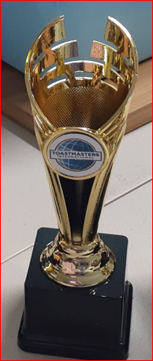
Trophy Awards
TGC116A SILVER 150MM $15
TGC116B SILVER 180MM $18
TGC116C SILVER 210MM $21
TGC115A GOLD 150MM $15
TGC115B GOLD 180MM $18
TGC115C GOLD 210MM $21*

Slide 34
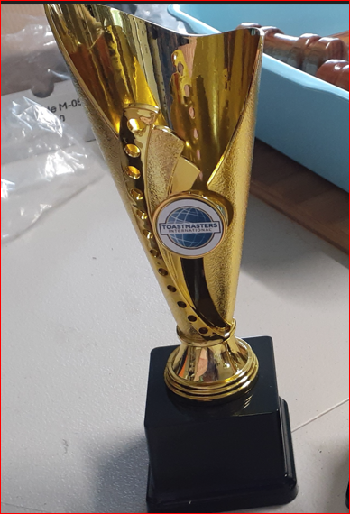
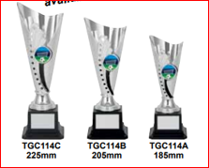
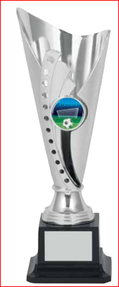
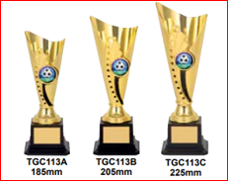
Trophy Awards
TGC114A 185MM $15*
TGC114B 205MM $18
TGC114C 225MM $21
TGC113A 185MM $15
TGC113B 205MM $18*
TGC113C 225MM $21

Slide 35
Trophy Awards
TGG22025 Silver Royal Blue Interior 250mm $20
TGG2026 Silver Royal Blue Interior 280mm $26
*(L PICTURE) TGG22027 Gold Grass Green Interior 260mm $22
*(r PICTURE) TGG22028 Gold Grass Green Interior 275mm $24
TGG22029 Gold Deep Blue Interior 250mm $20
TGG22030 Gold Deep Blue Interior 285mm $28
TGG22032 Gold Deep Red Interior 280mm $26
TGG22034 Gold Deep Red Interior 250mm $20
TGG22033 Silver Deep green Interior 250mm $20
TGG22034 Silver Deep Green Interior 285mm $28
TGG22036 Silver Fire engine Red 275mm $24
TGG22035 Silver Fire Engine Red 250mm $20
TGG22027
TGG22028

Slide 36
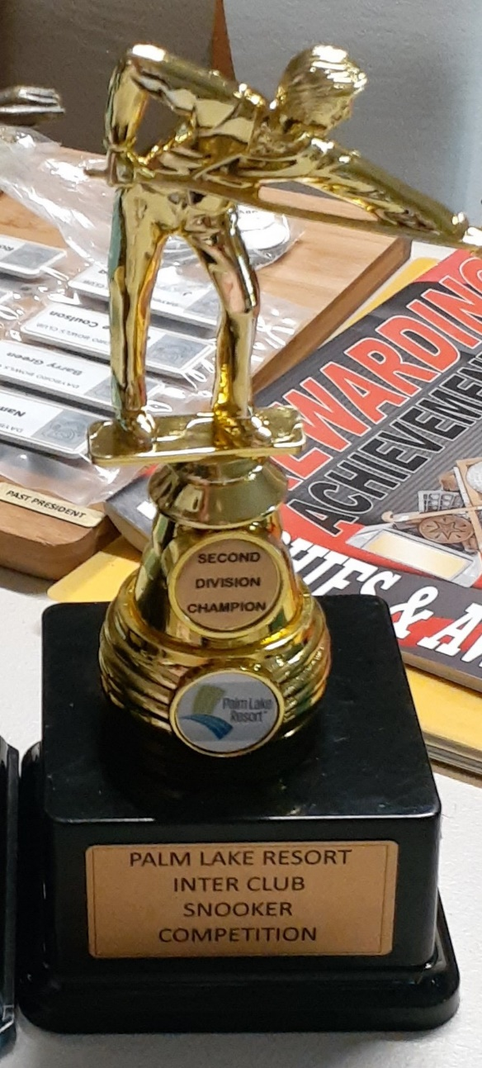
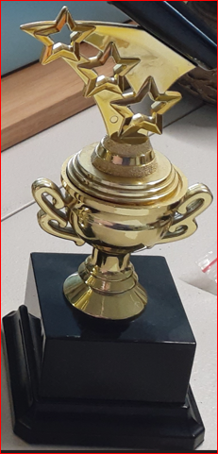
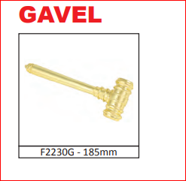
Trophy awards
Awards made to your sport choice

Slide 37
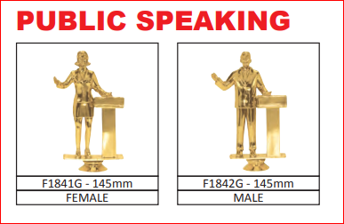
Trophy Awards
Awards made to your choice

Slide 38
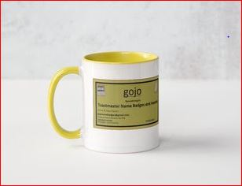
MUG AWARDS

Slide 39
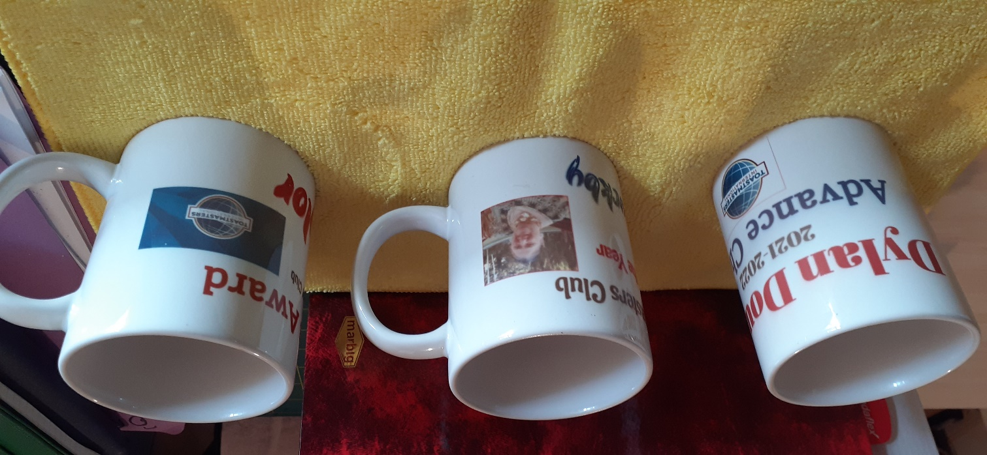
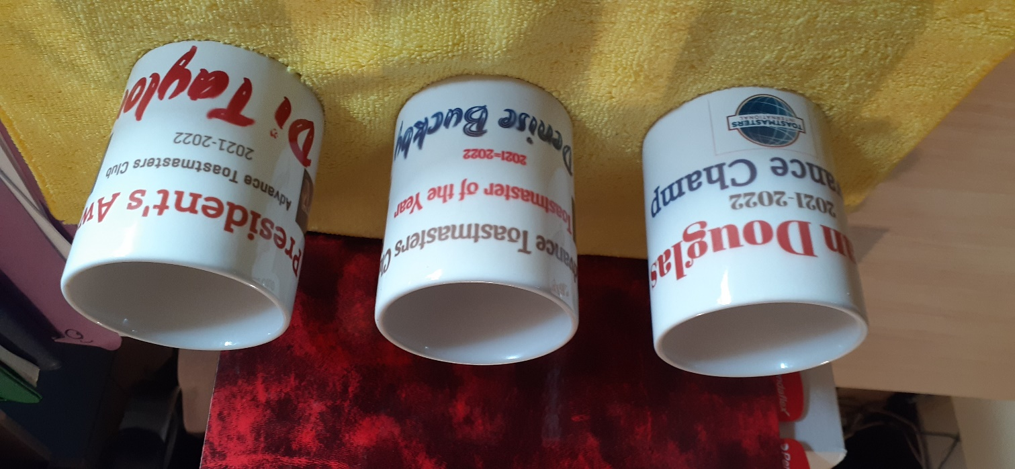
Mugs 11oz
Plain white mugs $10 each
Coloured mugs $14 each
Mugs
Your design Your mug
A wonderful gift that is so useful.
Supply a jpg photo and the wording you would like.
That’s all there is to it.

Slide 40
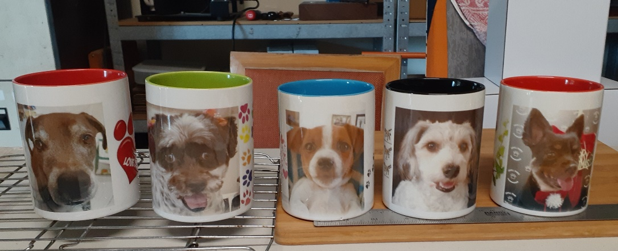
Mugs
Tall Coloured Mugs $20 plus Postage & handling $10

Slide 41
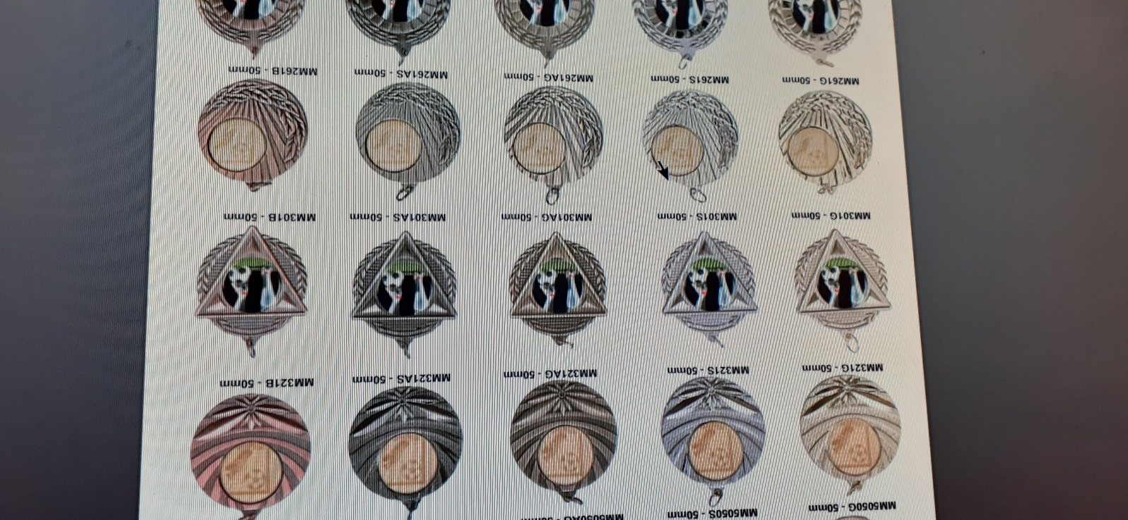
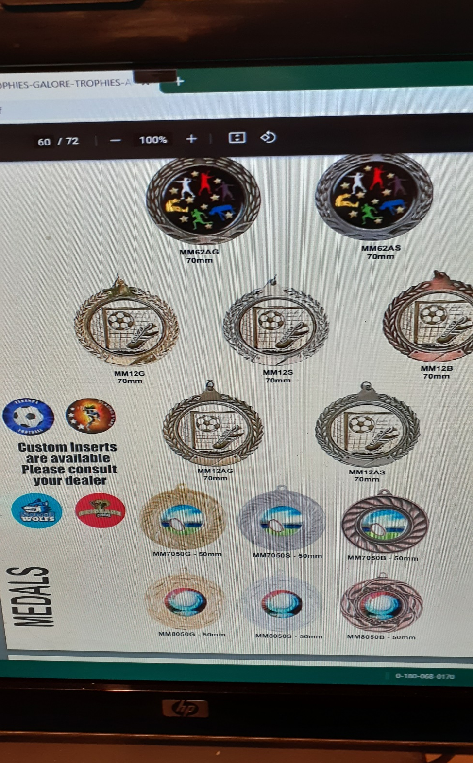
Medals styles
$8.00
Have your club logo inserted

Slide 42
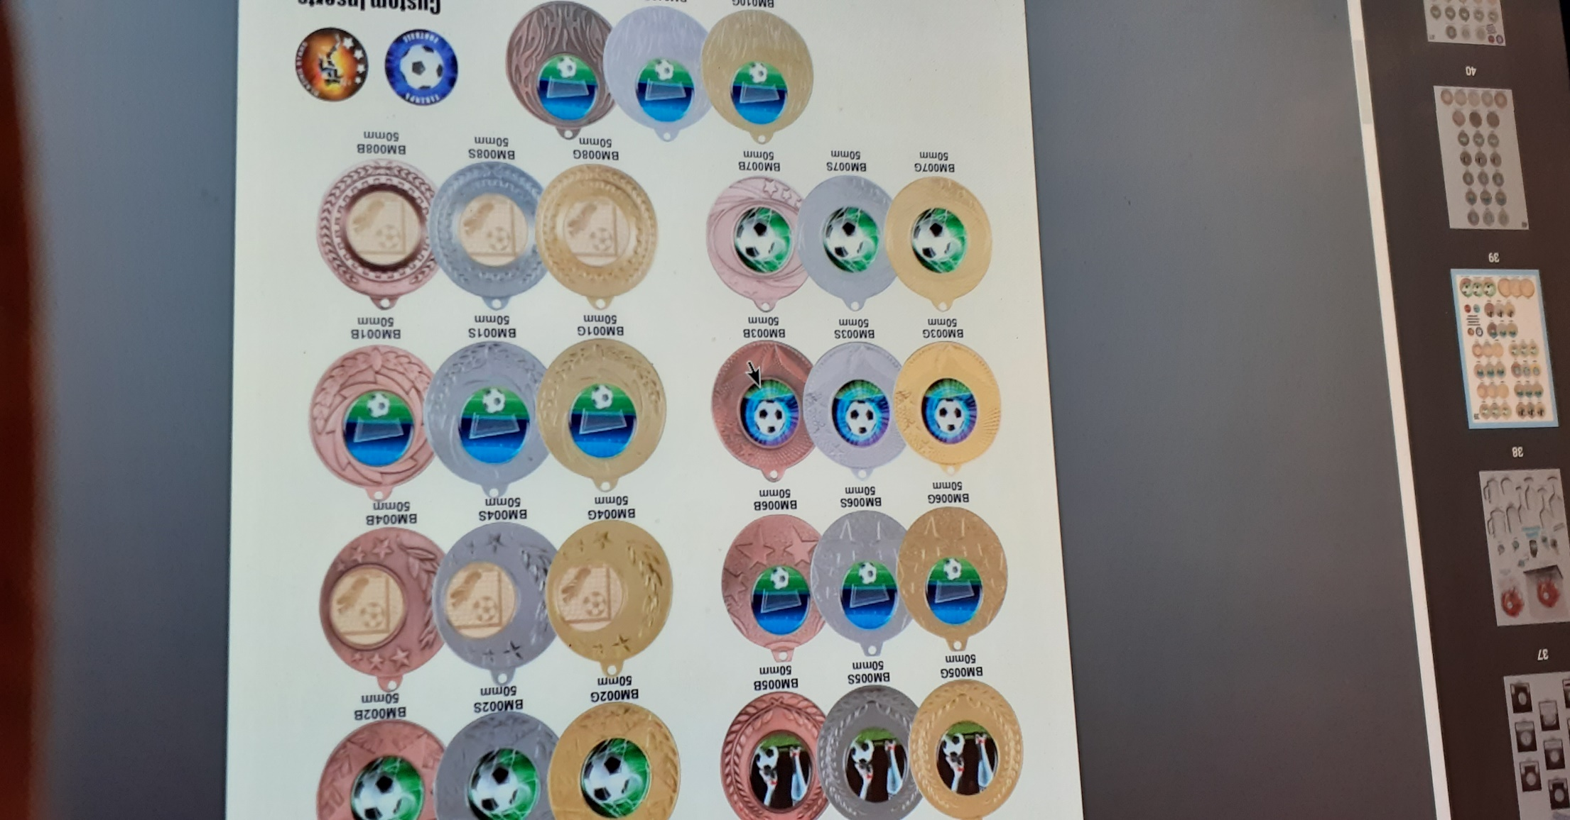
Medals

Slide 43
MEDALLIONS
Gold Silver Bronze

Slide 44
Medallions
Medallions
Size 50mm diameter insert.
$10 each with colour of choice lanyard.
Plate plaque applied to back

Slide 45
Payment Details
PAYMENT or pay online using CLUB NAME as payment reference to Jennifer R Owens ANZ BSB 014 228 ACCOUNT No. 324726254 or by credit card below PLEASE NOTE Direct Deposit orders will not be processes until payment confirmed

Slide 46
Payment Details
PLEASE NOTE Direct Deposit orders will not be processes until payment confirmed
Charge my Mastercard ☐ Visa ☐ (no American Express)
Credit Card Number
EXPIRY DATE CVV
CVV Last 3 numbers on back of card. Your payment cannot be processed without CVV number
Card Holders Name :
Amount Authorised Card Holders Signature
Date order required by: Pick up personally☐ or postage☐

Slide 47
GOJO
Gary and I thank you for your orders and we hope we have been of service to you.
We love to hear your feedback to improve our services to you, so do let us know.
Jenny

