Slide 1
CLUB LEADER TRAINING
Round 2
Sat 9th Feb 2019
CLUB TO RSVP
Moreton Division Toastmasters
Saturday 9th February 2019
8.15 arrival for 8.30am-4.00pm
Redcliffe Community Centre
Sponsored by District 69 | $10 p.p.

Slide 2
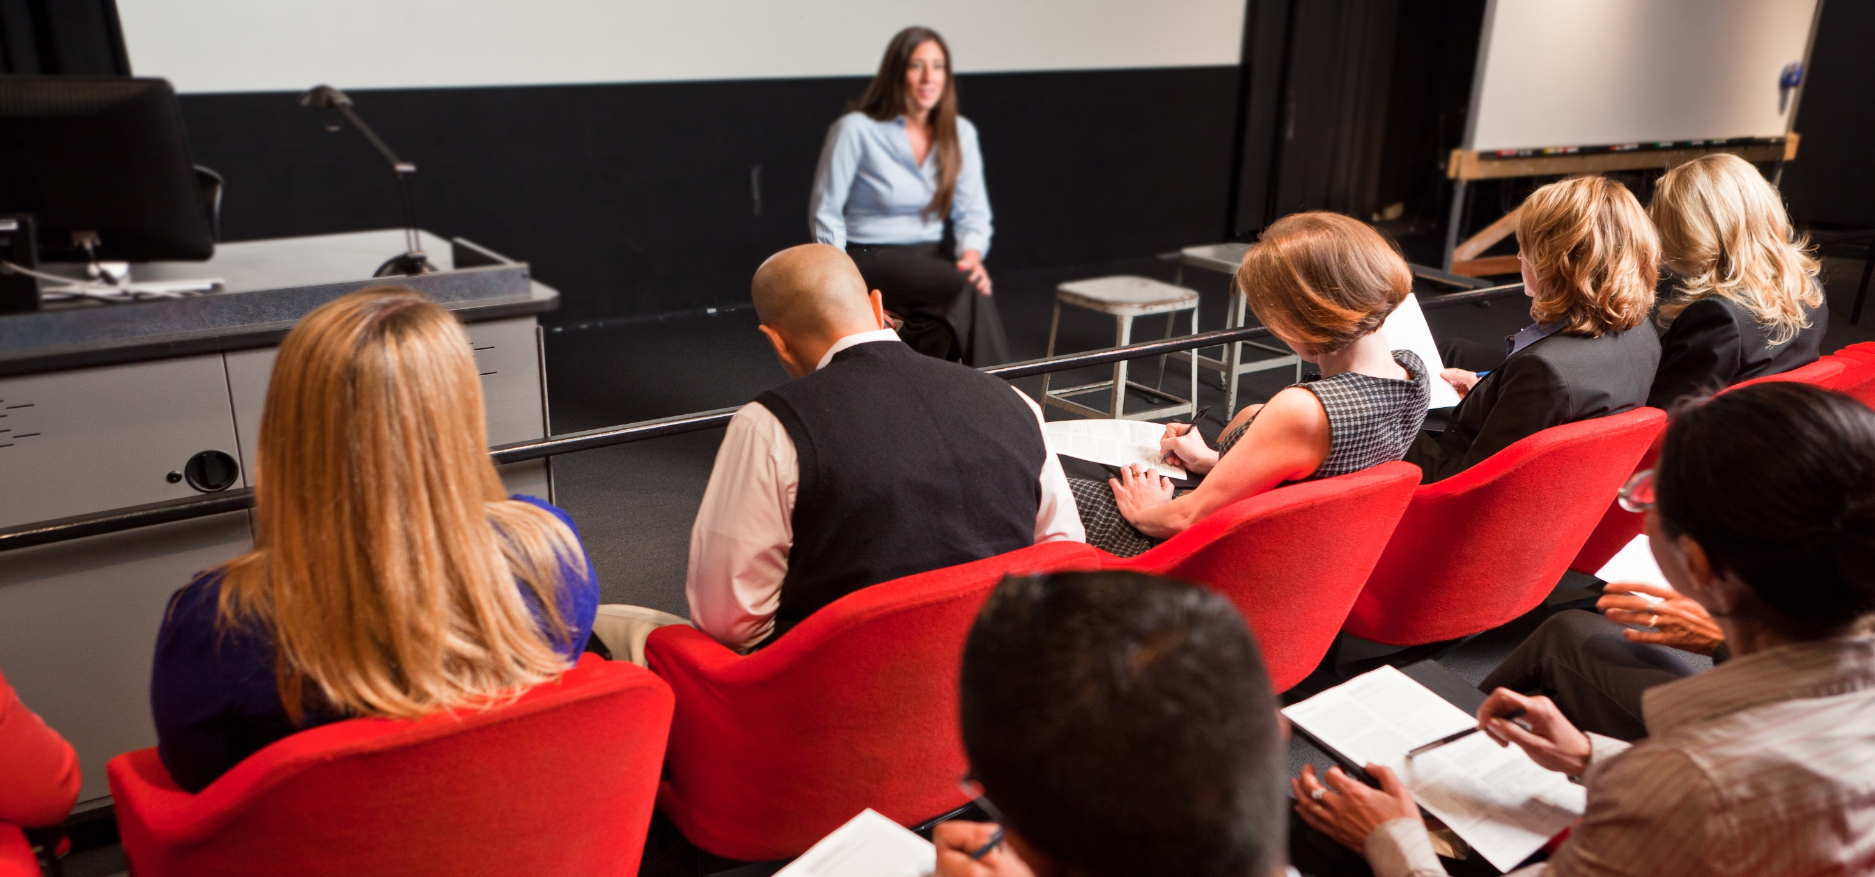
CLUB LEADER TRAINING
Round 2
Sat 9th Feb 2019
CLUB TO RSVP
Moreton Division Toastmasters
Saturday 9th February 2019
8.15 arrival for 8.30am-4.00pm
Redcliffe Community Centre
Sponsored by District 69 | $10 p.p.

Slide 3
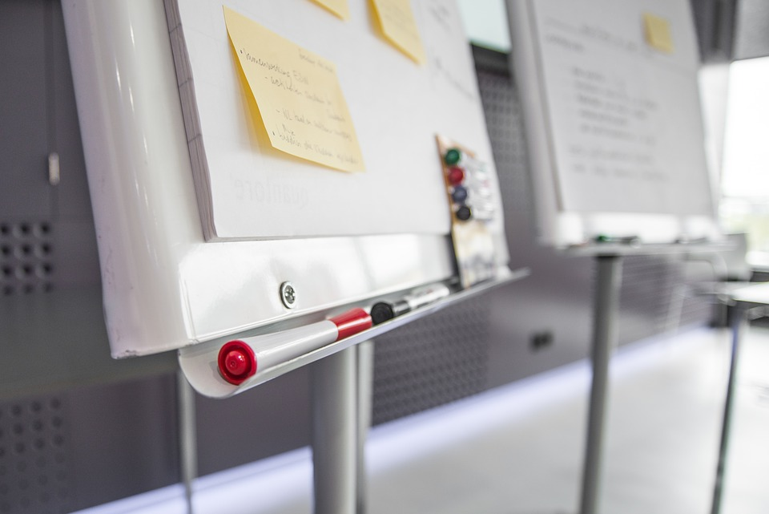
CLUB LEADER TRAINING
Round 2
Sat 9th Feb 2019
CLUB TO RSVP
Moreton Division Toastmasters
Saturday 9th February 2019
8.15 arrival for 8.30am-4.00pm
Redcliffe Community Centre
Sponsored by District 69 | $10 p.p.

Slide 4
Tips to create Facebook Event Banner Image
Use Toastmaster branding approved fonts and colours
Use Toastmasters images or non-licenced images (unsplash.com, pixabay.com, etc.)
Update PPT slide with event details
Save PPT
Then save PPT slide as ‘jpg’ image (this slide only)
Upload picture ‘jpg’ image to Facebook event

Slide 5
Tips to upload Event Flyer in Facebook event
Save word document Event flyer as PDF version
Use a converter program such as https://pdf2jpg.net/ to upload PDF and convert to ‘jpg’ version
Download the ‘jpg’ image created
Create post in Facebook event and upload ‘jpg’ as a ‘picture’

